Slide 1
Self-contained Systems (SCS)
An architectural approach that separates a larger system’s functionality into many independent, collaborating systems.
Created by
. Driven by the Community.
The content in this info deck is licensed under the Creative Commons attribution-sharealike 4.0 international license.

Slide 2
A monolith contains numerous things inside of a single system…

Slide 3
Various Domains

Slide 4
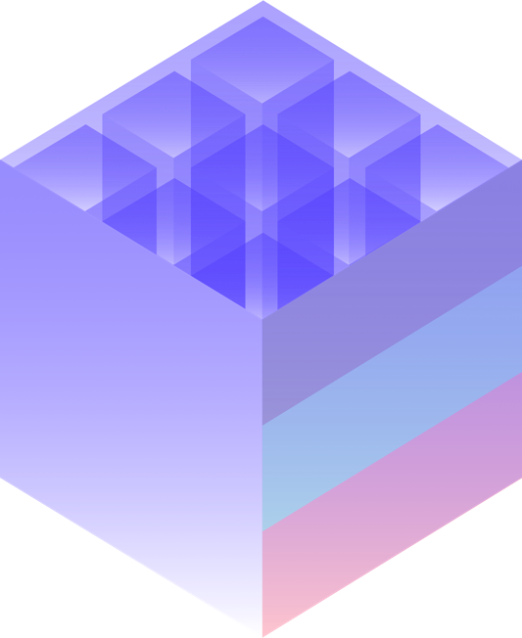
User interface Business logic Persistence

Slide 5
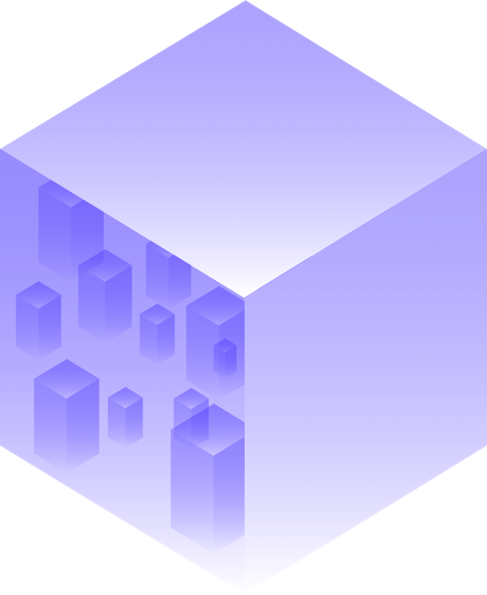
…as well as a lot of modules, components, frameworks, and libraries.

Slide 6
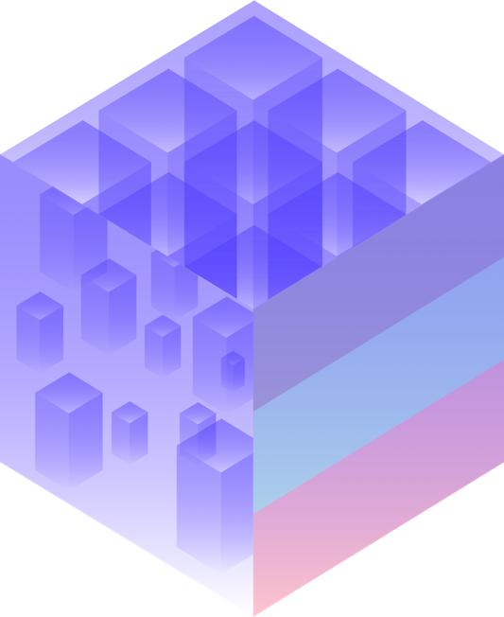
With all these layers in one place, a monolith tends to grow.

Slide 7
With all these layers in one place, a monolith tends to grow.

Slide 8
If you cut a monolithic system along its very domains…

Slide 9
…and wrap every domain in a separate, replaceable web application…

Slide 10
…then that application can be referred to as a self-contained system (SCS).

Slide 11
On its outside, an SCS is a decentralized unit that is communicating with other systems via RESTful HTTP or lightweight messaging.

Slide 12
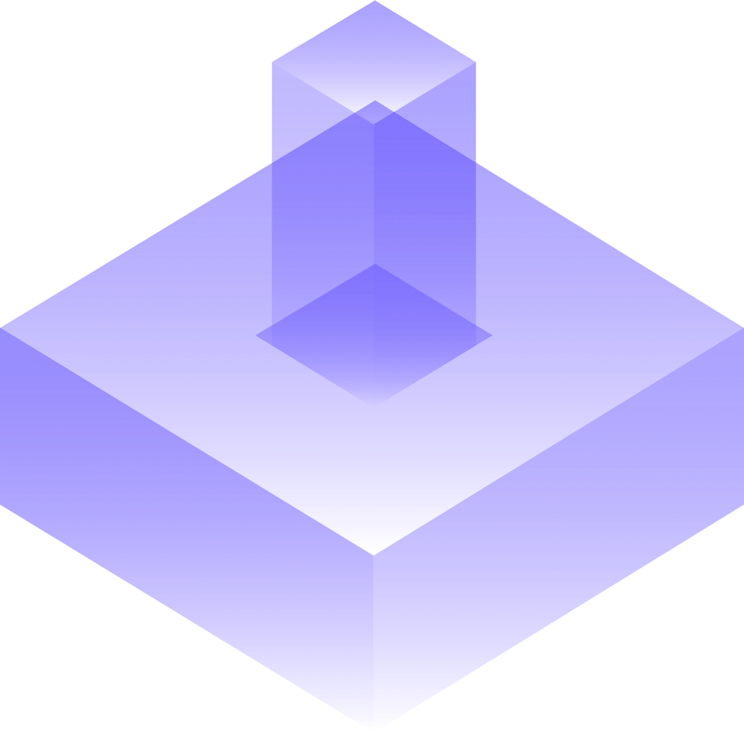
Therefore self-contained systems can be individually developed for different platforms.

Slide 13
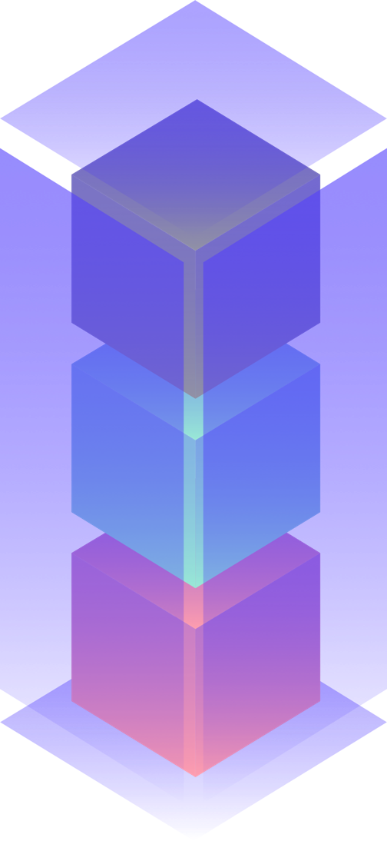
An SCS contains its own user interface, specific business logic, and separate data storage

Slide 14
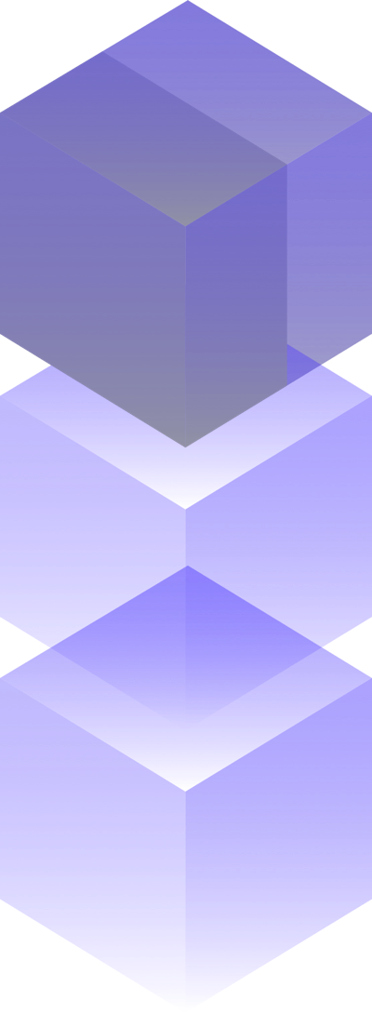
In addition to a web interface, a self-contained system can also provide an optional API.

Slide 15
The business logic part solely addresses problems that occur within its core domain. This logic is shared with other systems only through a well-defined interface.

Slide 16
The business logic may comprise microservices designed to solve domain-specific problems.

Slide 17
Every SCS brings its own data storage and with it redundant data depending on the context and domain.

Slide 18
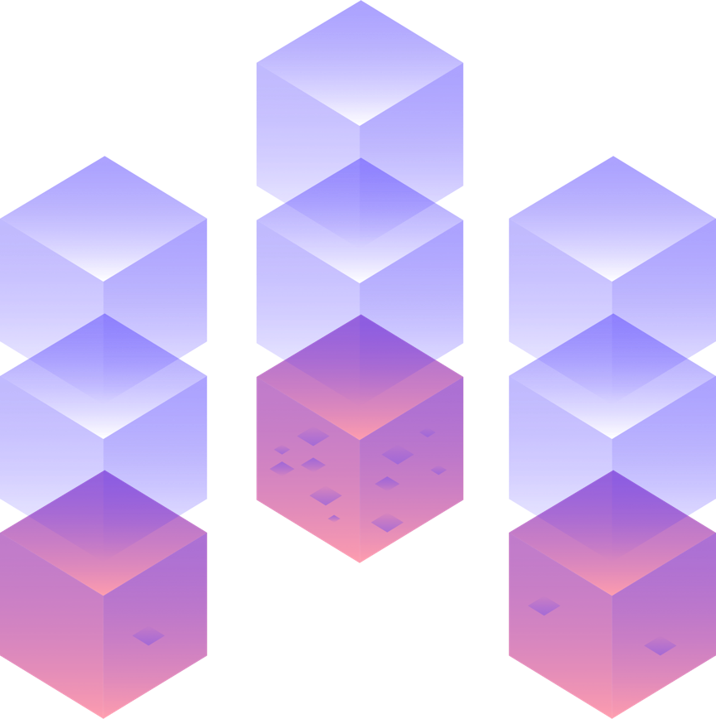
These redundancies are tolerable as long as the sovereignty of data by its owning system is not undermined.

Slide 19
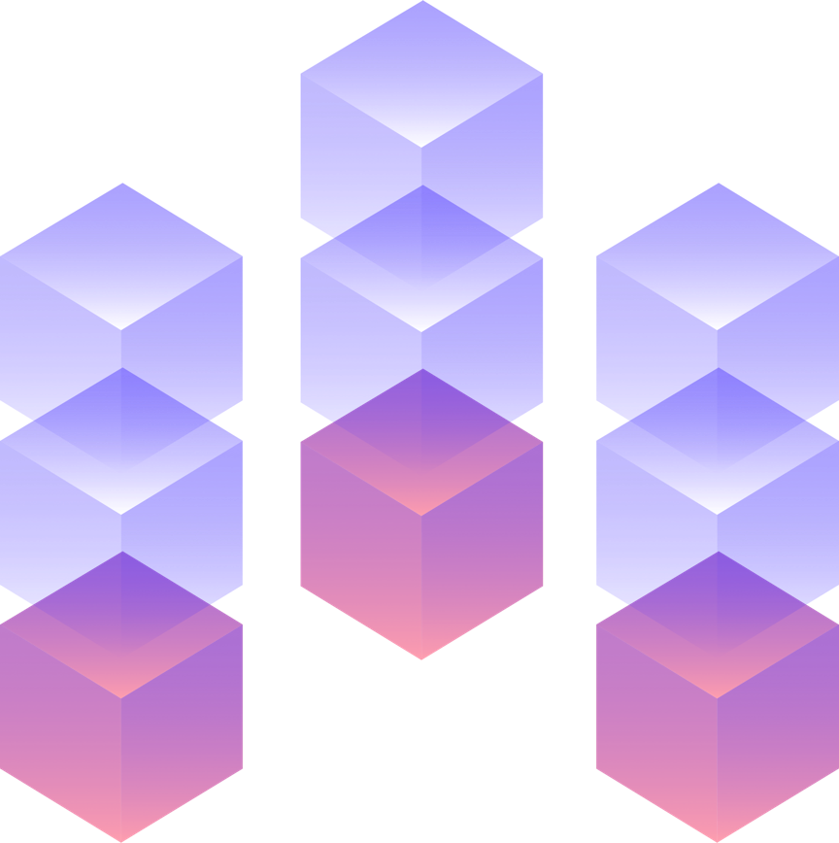
This enables polyglot persistence, implying that a database can be selected to solve a domain specific problem, rather than to fulfill a technical urge.
CouchDB
Neo4J
Oracle

Slide 20
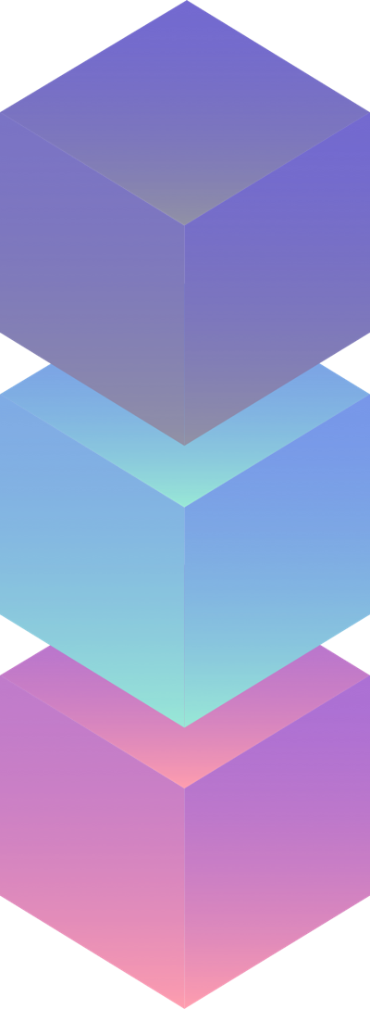
Within a self-contained system, a variety of technical decisions can be made independently from other systems, such as choices regarding programming language, frameworks, tooling, or workflow.

Slide 21
Team 2
Team 3
The manageable domain specific scope enables the development, operation, and maintenance of an SCS by a single team.
Team 1

Slide 22
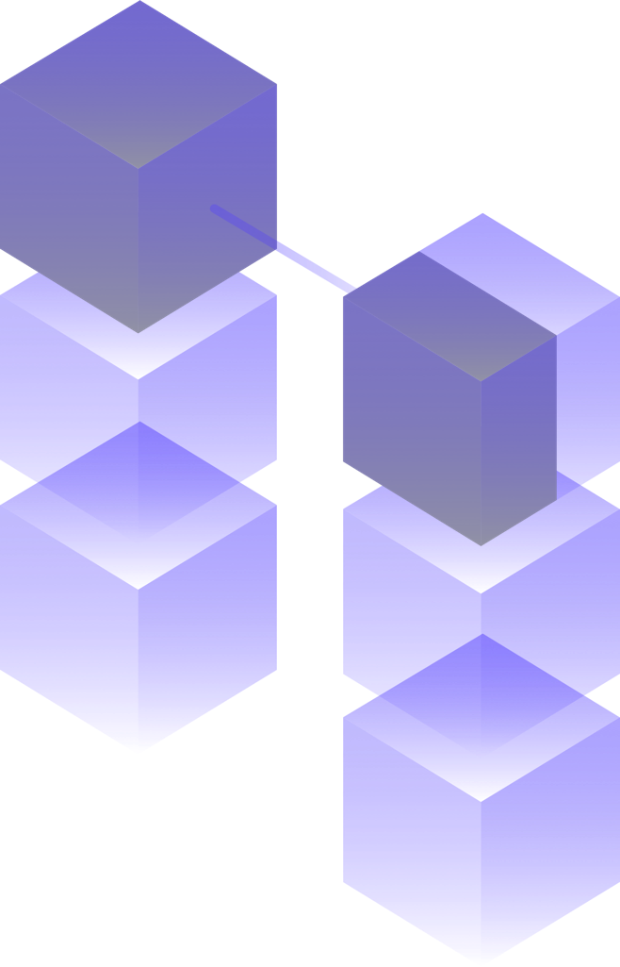
Self-contained Systems should be integrated via their web interfaces to minimize coupling to other systems.

Slide 23
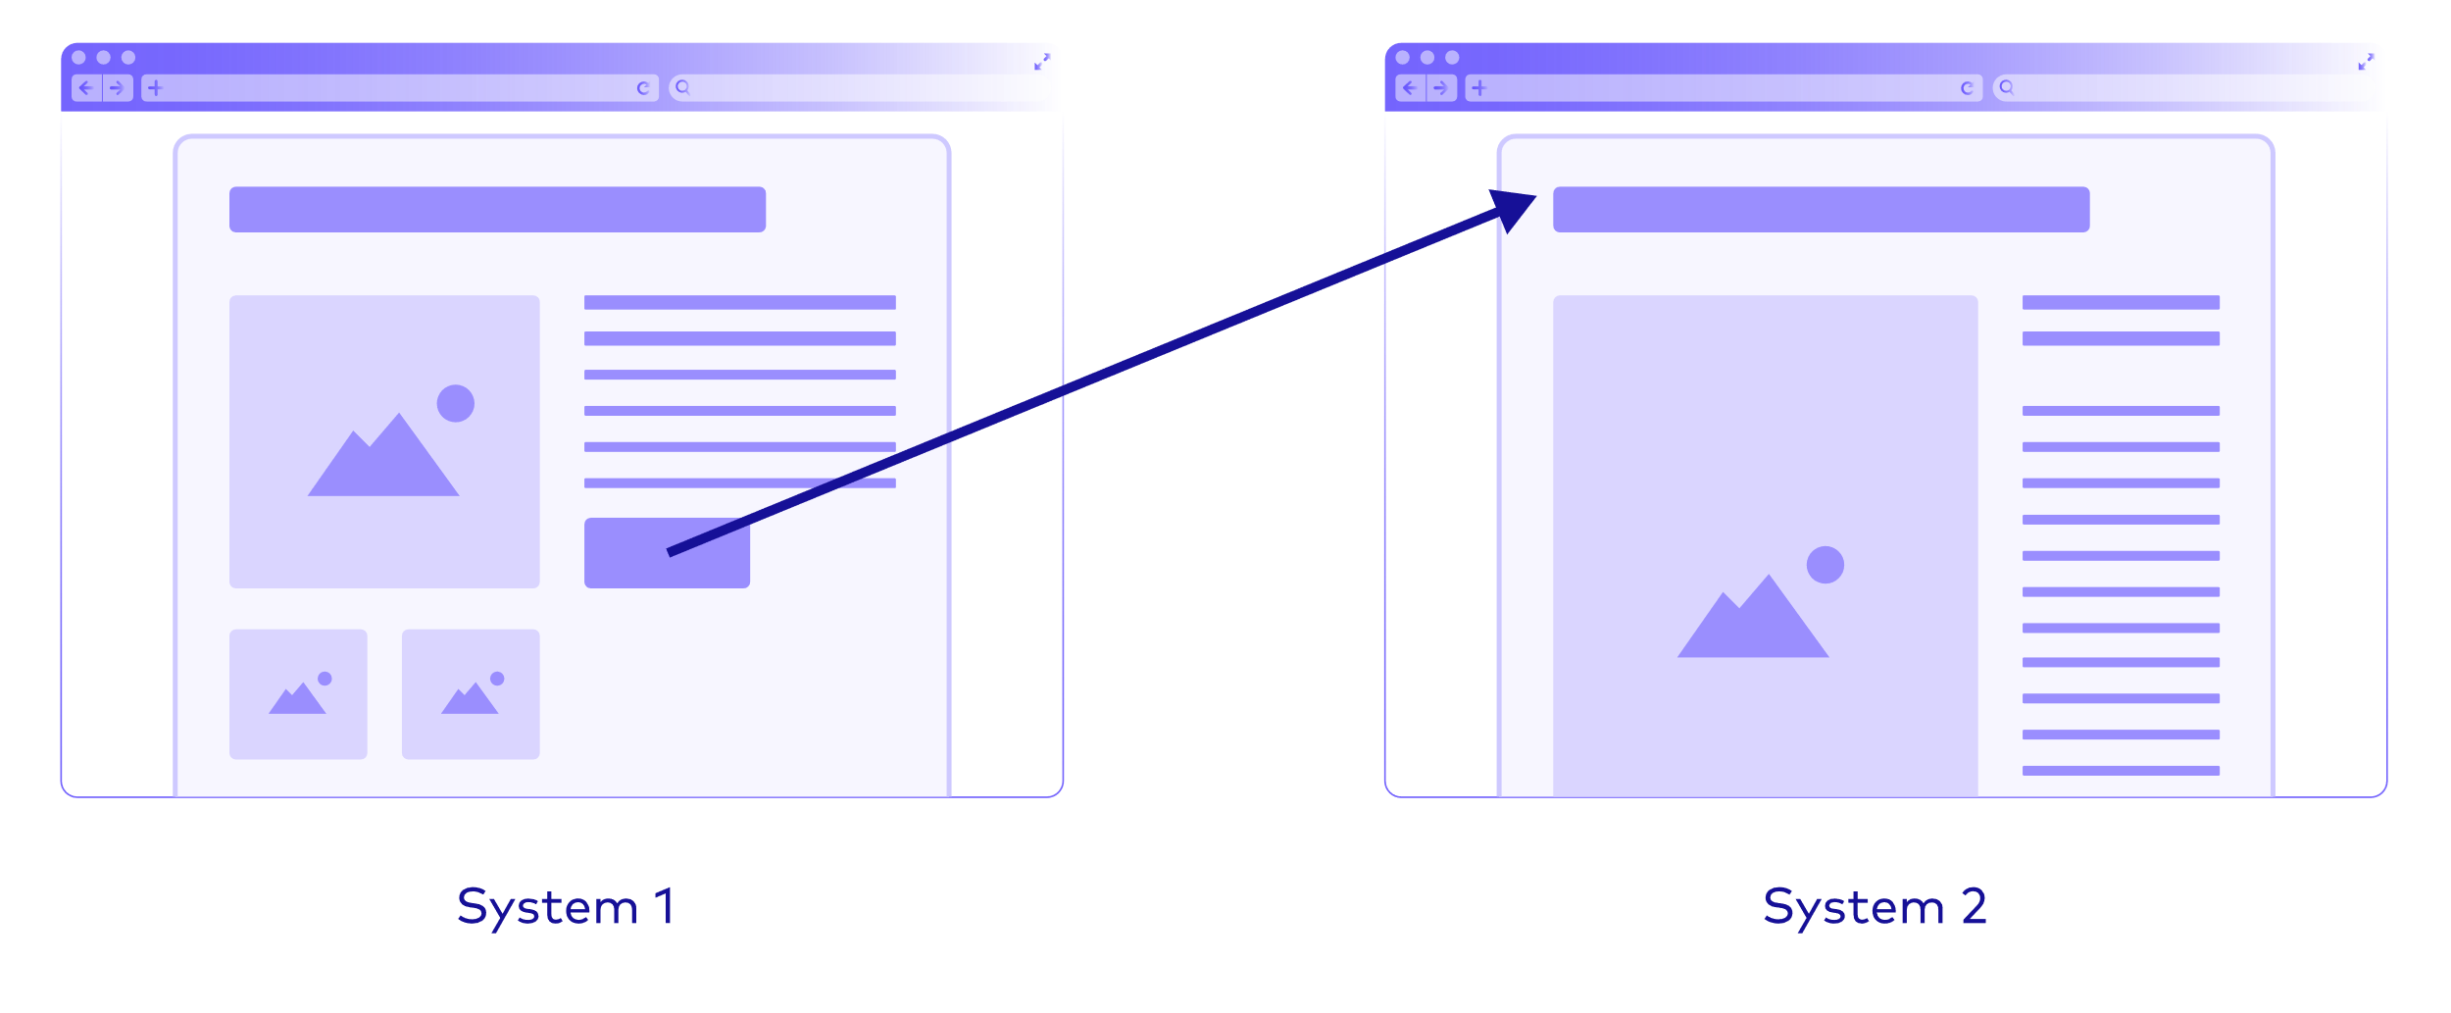
Therefore, simple hyperlinks can be used to navigate between systems.

Slide 24
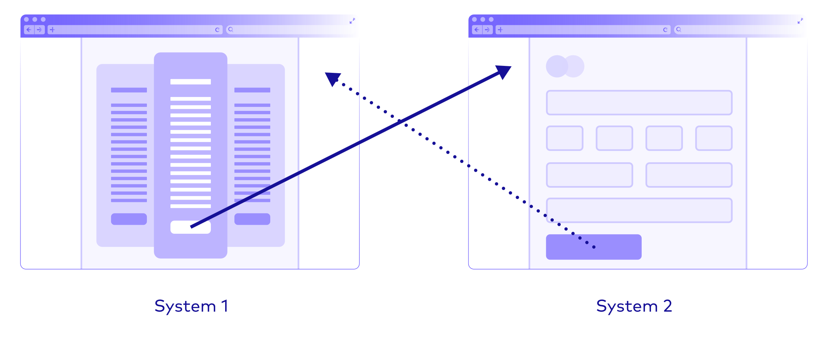
Redirection can be used to ensure navigation works in both directions.

Slide 25
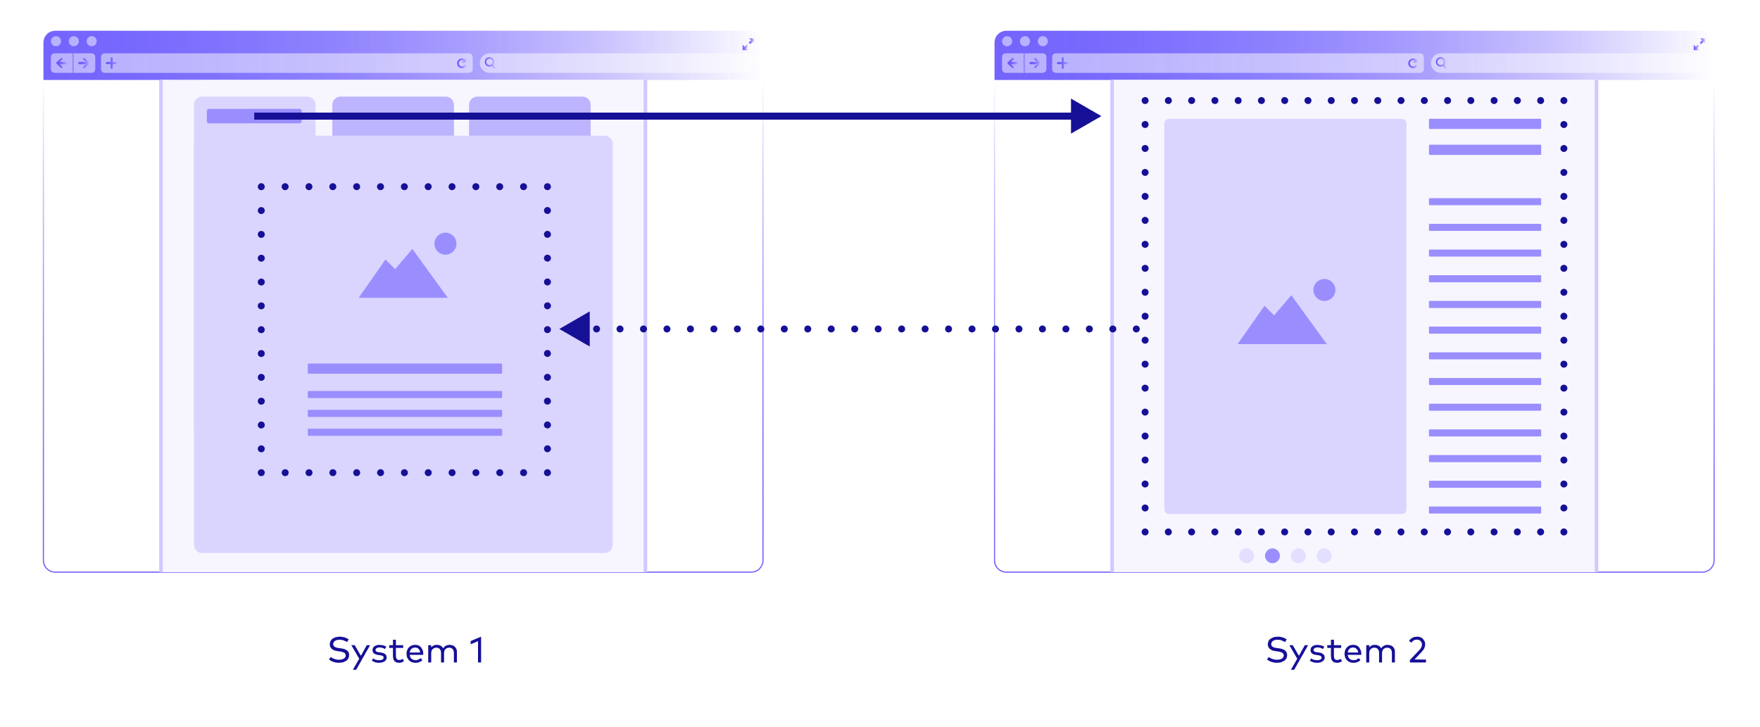
Hyperlinks can also facilitate the dynamic inclusion of content served by another application into the web interface of a self-contained system.

Slide 26
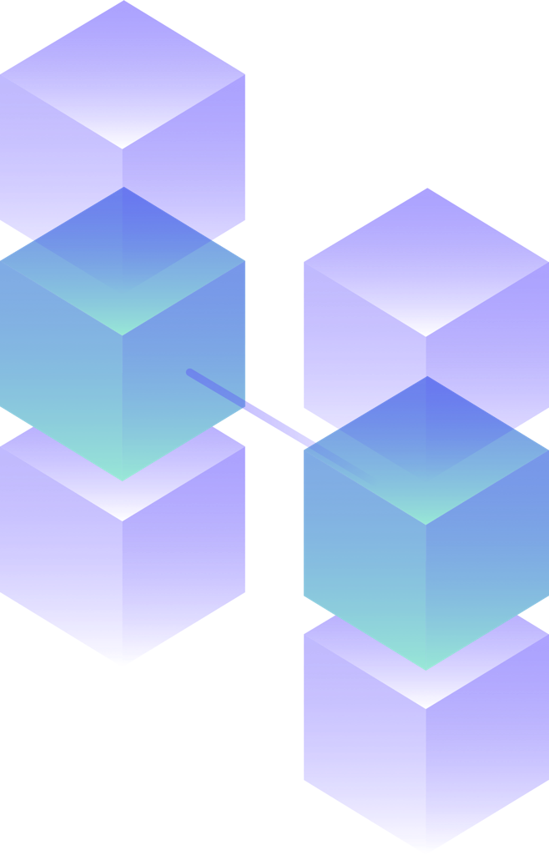
To further minimize coupling to other systems, synchronous remote calls inside the business logic should be avoided.

Slide 27
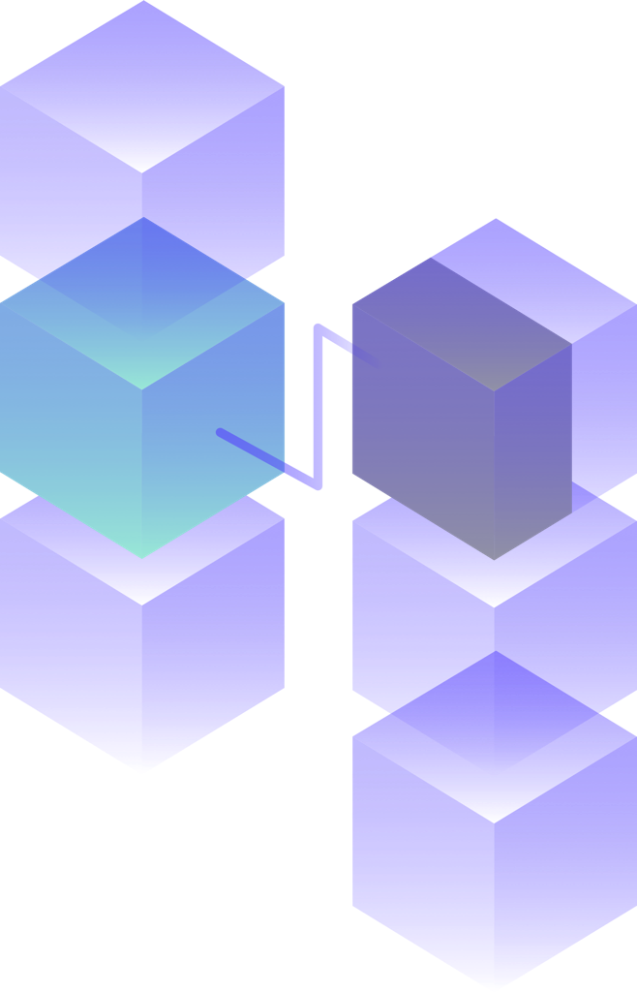
Instead, remote API calls should be handled asynchronously to minimize dependencies and prevent error cascades.

Slide 28
This implies that, depending on the desired rate of updates, the data model’s consistency guarantees may be relaxed.

Slide 29
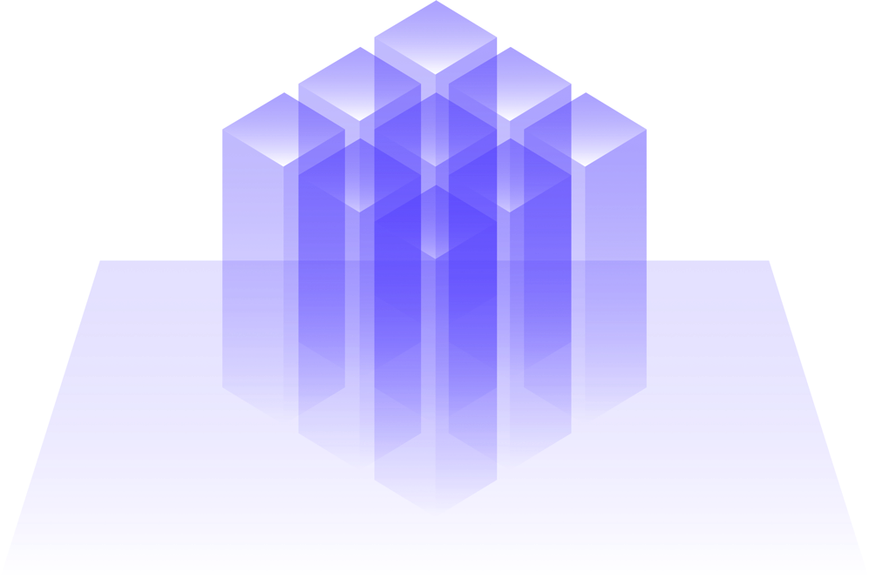
An integrated system of systems like this has many benefits.

Slide 30
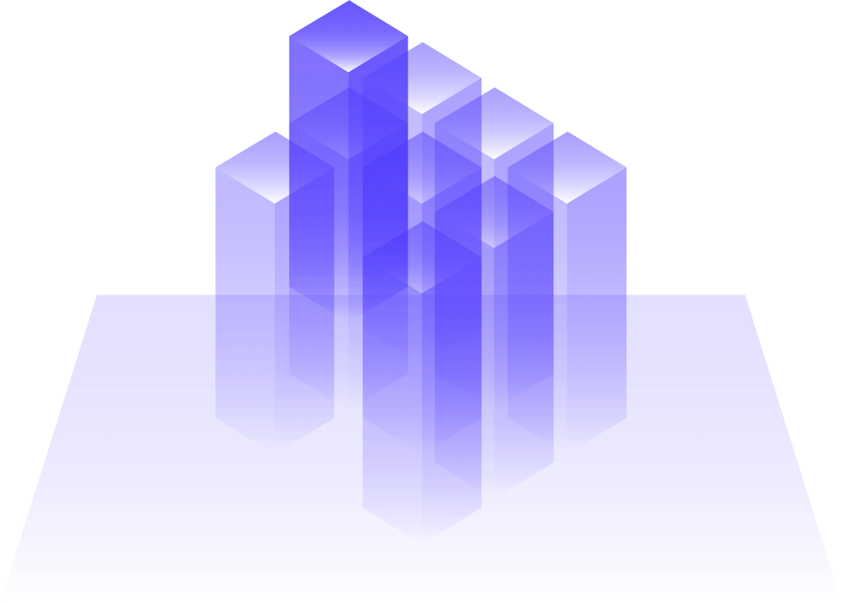
Overall, resilience is improved through loosely coupled, replaceable systems.

Slide 31
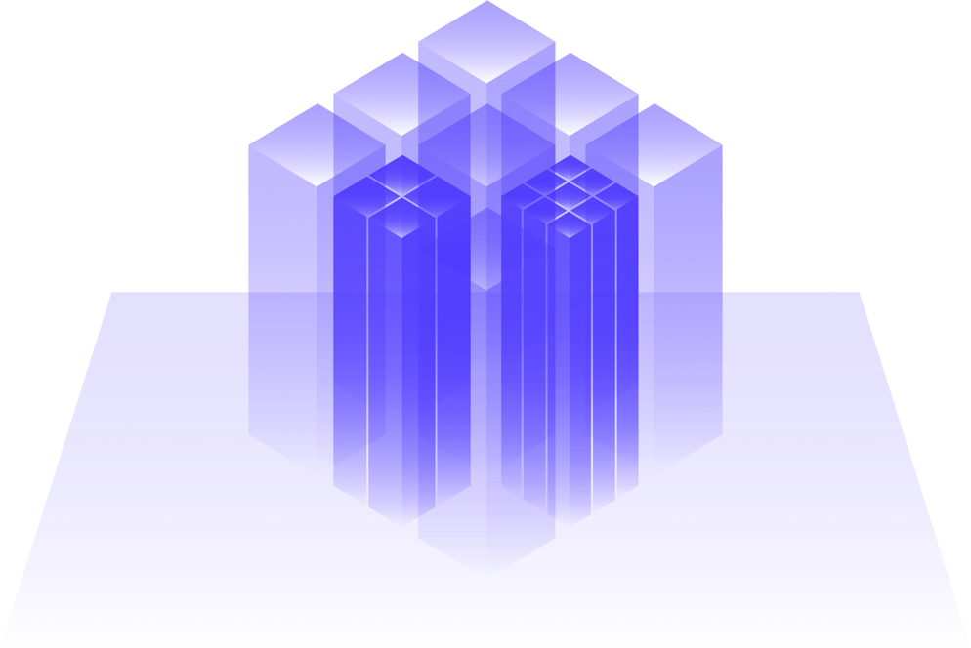
Some systems can be individually scaled to serve varying demands.

Slide 32
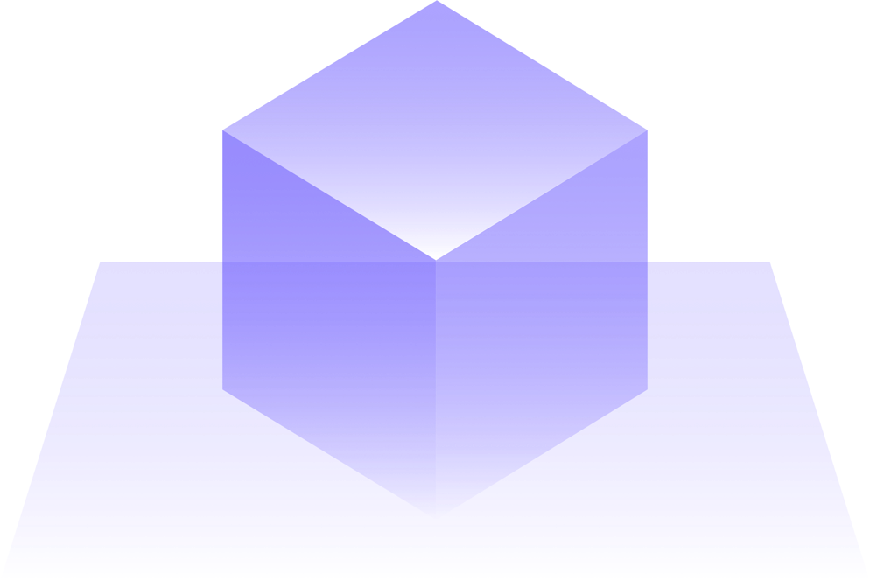
Version 1
It’s not necessary to carry out a risky big bang release to migrate an outdated, monolithic system into a system of systems.

Slide 33
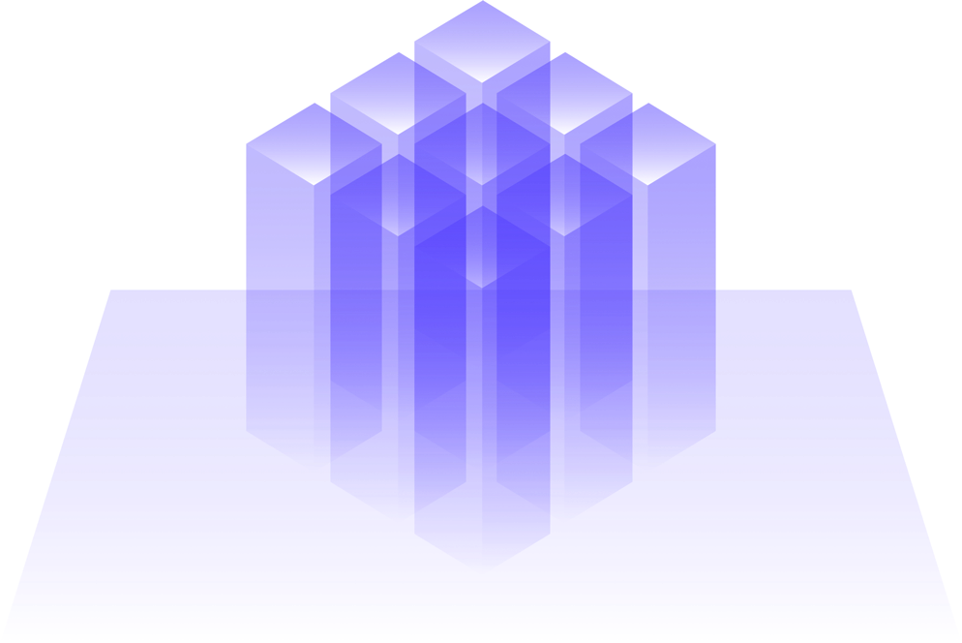
Version 2
It’s not necessary to carry out a risky big bang release to migrate an outdated, monolithic system into a system of systems.

Slide 34
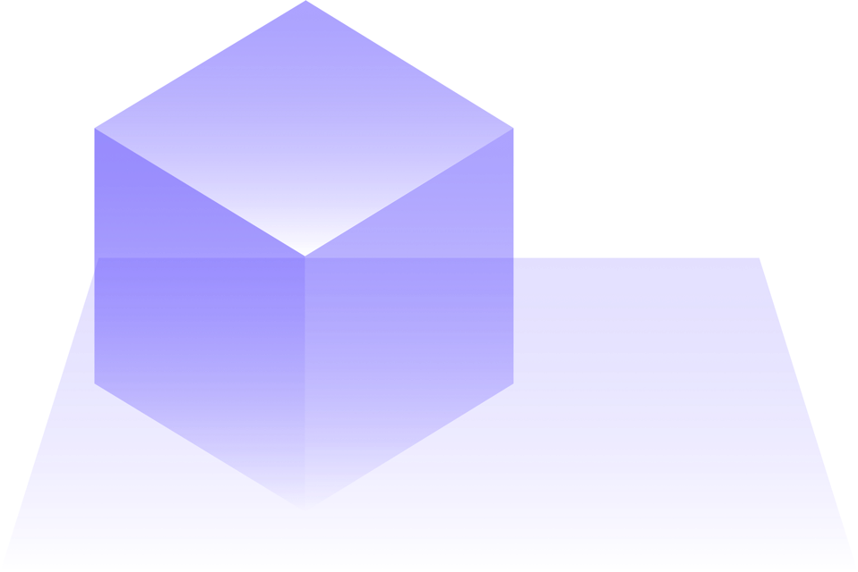
Instead, migration can occur in small, manageable steps that minimize the risk of failure and lead to an evolutionary modernization of large and complex systems.

Slide 35
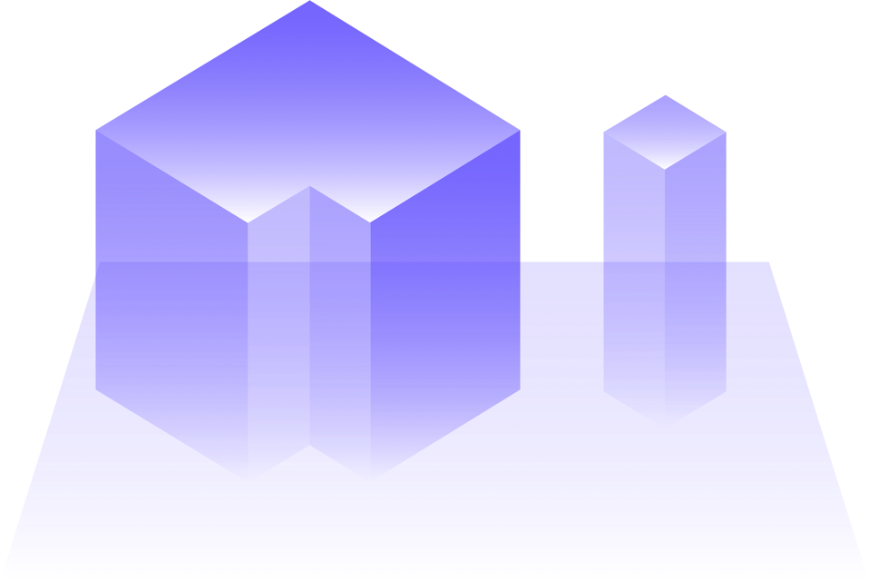
Instead, migration can occur in small, manageable steps that minimize the risk of failure and lead to an evolutionary modernization of large and complex systems.

Slide 36
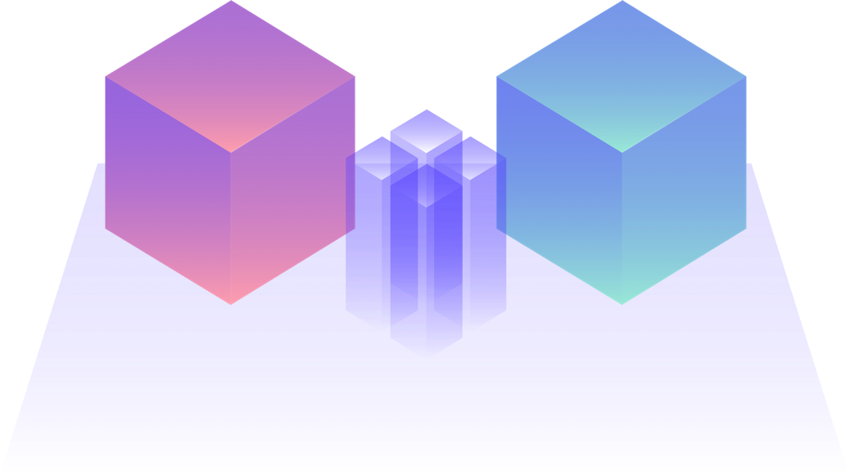
In reality a system of systems consists of individually developed software and standard products.

Slide 37
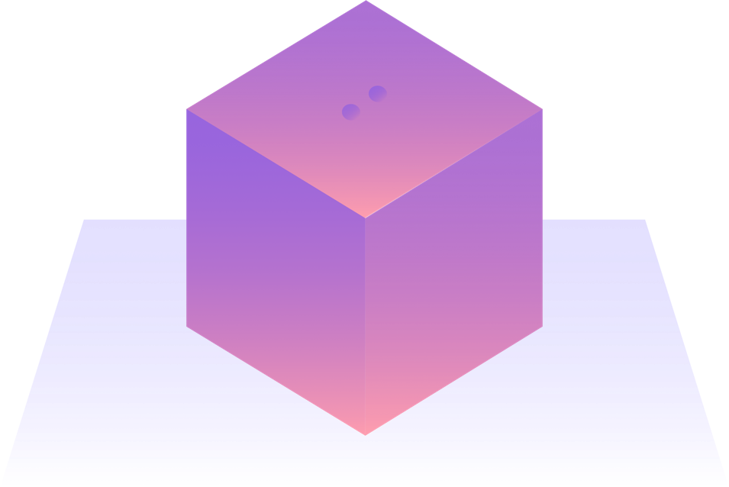
A product that fits well into a system of systems can be selected based on the following aspects: it should solve a defined set of tasks and provide the same integration mechanisms that a self-contained system offers.

Slide 38
This ensures that products can be replaced safely by other products once their lifetime has ended.

Slide 39
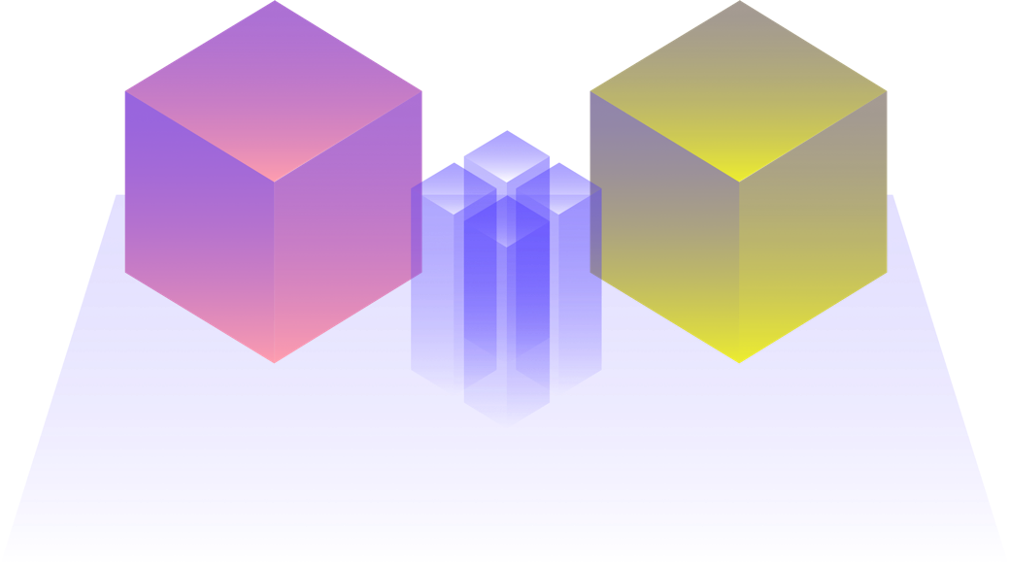
This ensures that products can be replaced safely by other products once their lifetime has ended.

Slide 40
If a product with such integration mechanisms cannot be found, it should at least be possible to extend that product with uniform interfaces that integrate smoothly with the rest of the system.

Slide 41
www.innoq.com
You can explore more in-depth information about self-contained systems, microservices, monoliths, REST, or ROCA at innoq.com/scs
Looking to modernize your IT landscape? Or build something new? We’d love to assist you. Get in touch!
The content in this info deck is licensed under the Creative Commons attribution-sharealike 4.0 international license.

